Slide 1
INM707 Deep Reinforcement Learning Coursework Presentation
Elnara Mammadova & Jerome Titus

Slide 2
Basic Team Tasks

Slide 3
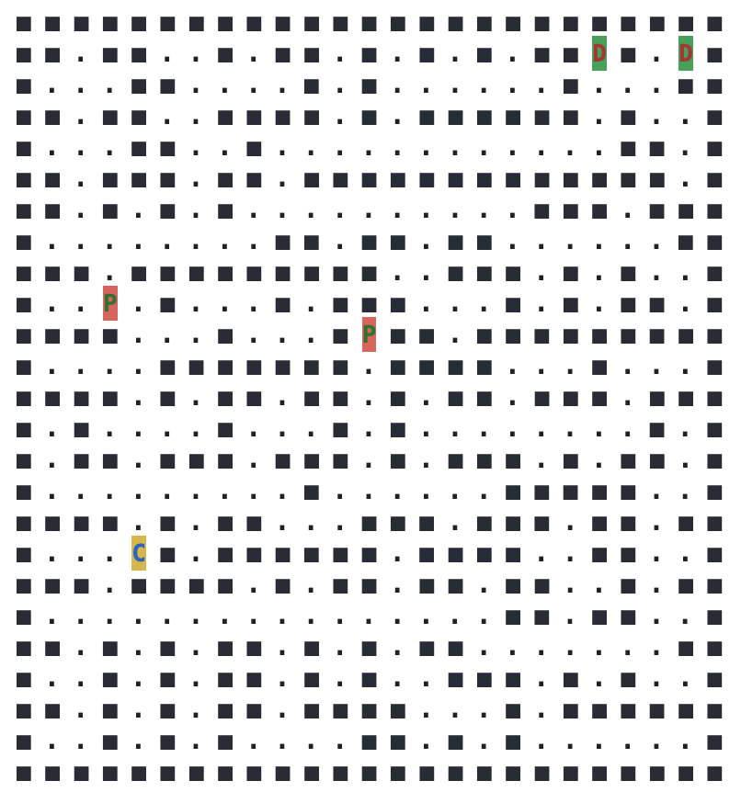
UberPool Environment
Build CityGrid maze using Randomized Prim's algorithm.
Start with a grid full of walls.
Pick a cell, mark it as part of the CityGrid. Add the walls of the cell to the wall list.
While there are walls in the list:
Pick a random wall from the list. If only one of the cells that the wall divides is visited, then:
Make the wall a passage and mark the unvisited cell as part of the CityGrid.
Add the neighboring walls of the cell to the wall list.
Remove the wall from the list.
Assign two random empty cells to passenger (pick-up - P) location
Assign two random empty cells to destination (drop-off - D) locations
Assign one random empty cell to car (agent - C) location
(https://en.wikipedia.org/wiki/CityGrid_generation_algorithm#Randomized_Prim's_algorithm)

Slide 4
Action space = { north, south, west, east, pick-up, drop-off}
State space = { environment-size x 7}
- Sub-space 1: Agent has not picked up either passenger
- Sub-space 2: Agent has picked up passenger 1, but not passenger 2
- Sub-space 3: Agent has picked up passenger 2, but not passenger 1
- Sub-space 4: Agent has picked up both passengers
- Sub-space 5: Agent has dropped passenger 1, but not passenger 2
- Sub-space 6: Agent has dropped passenger 2, but not passenger 1
- Sub-space 7:Agent has dropped both passengers at their respective destinations
Reward = { successful pick-up + environment-size/2
successful drop-off + environment-size
illegal pick-up – 10
illegal drop-off – 10
bumping an obstacle – 5
timestep penalty – 1 }
Sub-space 1
Sub-space 2
Sub-space 3
Sub-space 4
Sub-space 5
Sub-space 6
Sub-space 7
P₁
P₂
Ca
P₂
P₁
Ca
Ca
Ca
Ca
D₁
D₂
D₁
D₂
D₁
D₂
D₁
D₂
Ca
D₂
D₁
Ca
Terminal State

Slide 5
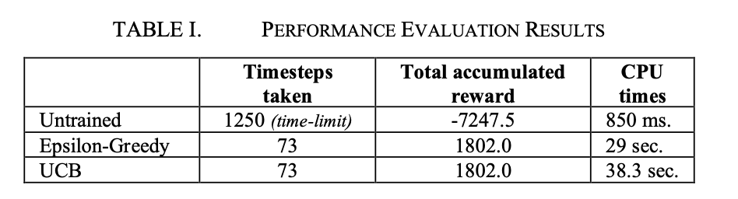
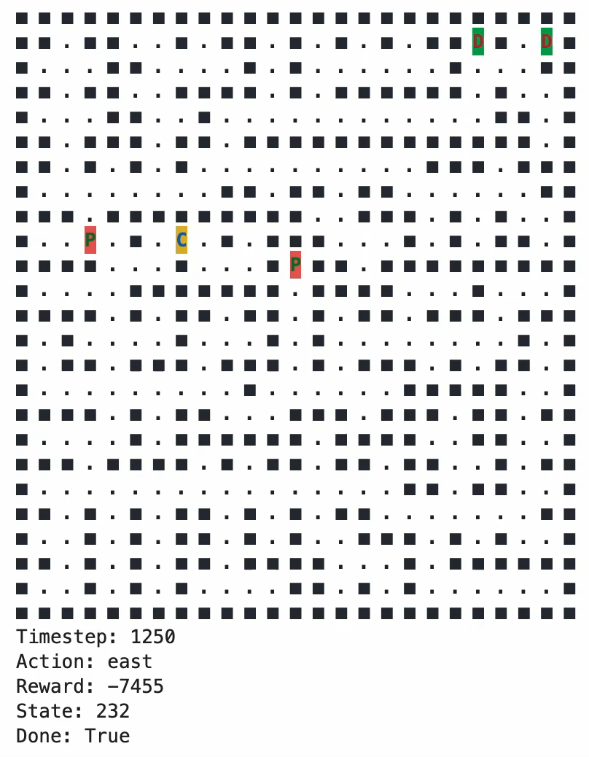
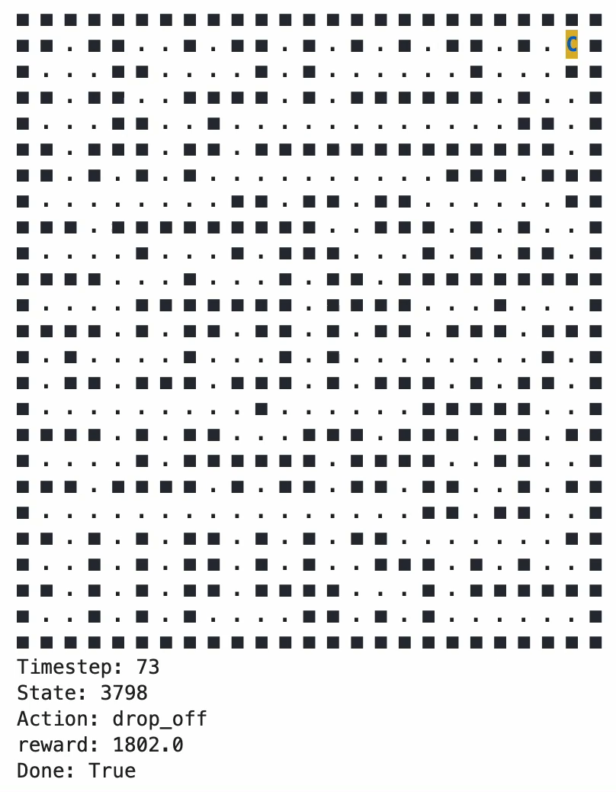
Untrained agent
Trained agent

Slide 6
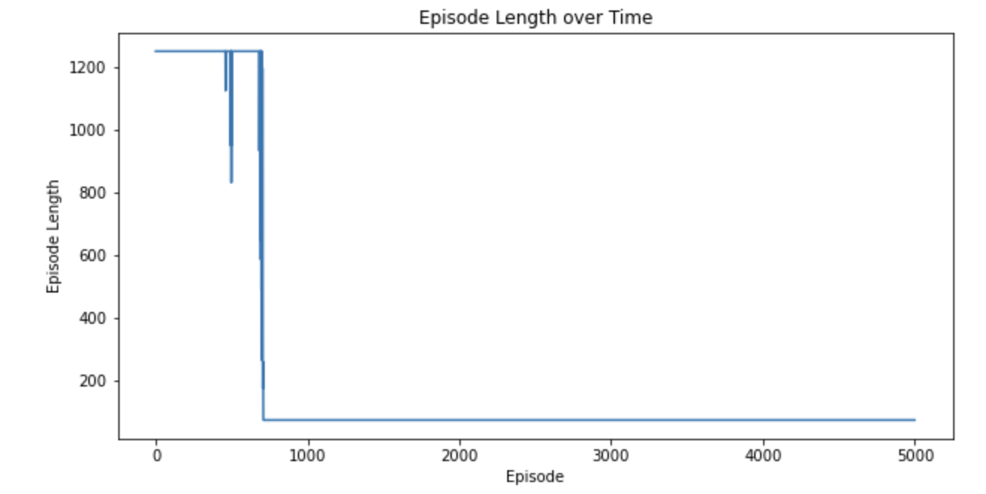
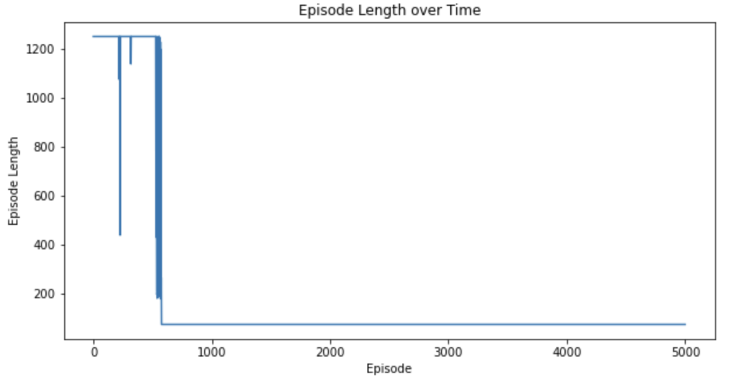
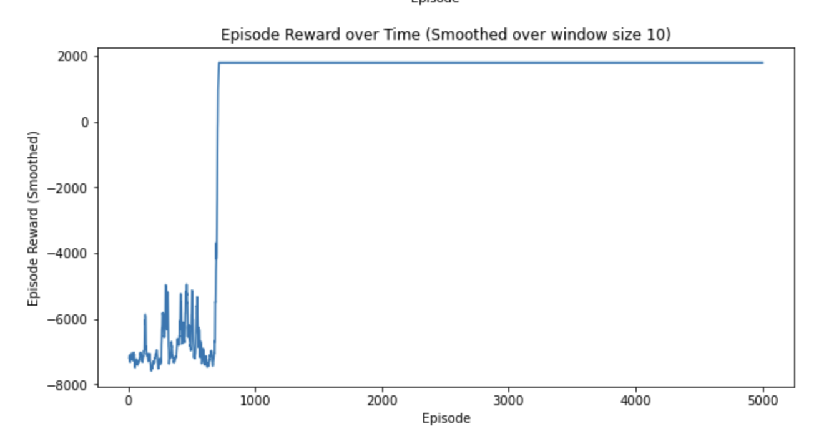
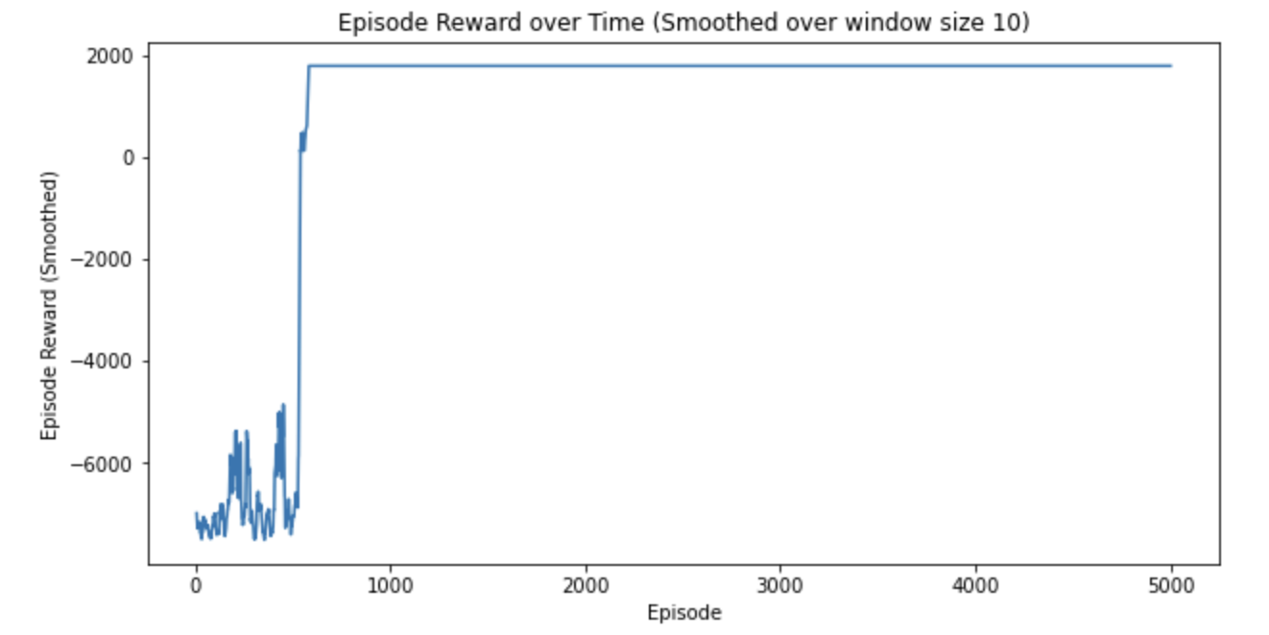
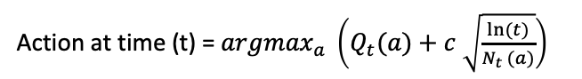
Epsilon-Greedy Policy
UCB (Upper Confidence Bound) Policy
Exploit
max Q_{t}(a) probability 1-ϵ
Action at time (t) = ${argmax}_{a} \left(Q_{t}(a)+c \sqrt{\frac{ln⁡(t)}{N_{t }(a)}}\right)$
Action at time (t)
Explore
random action (a) probability ϵ
Exploit
Explore

Slide 7
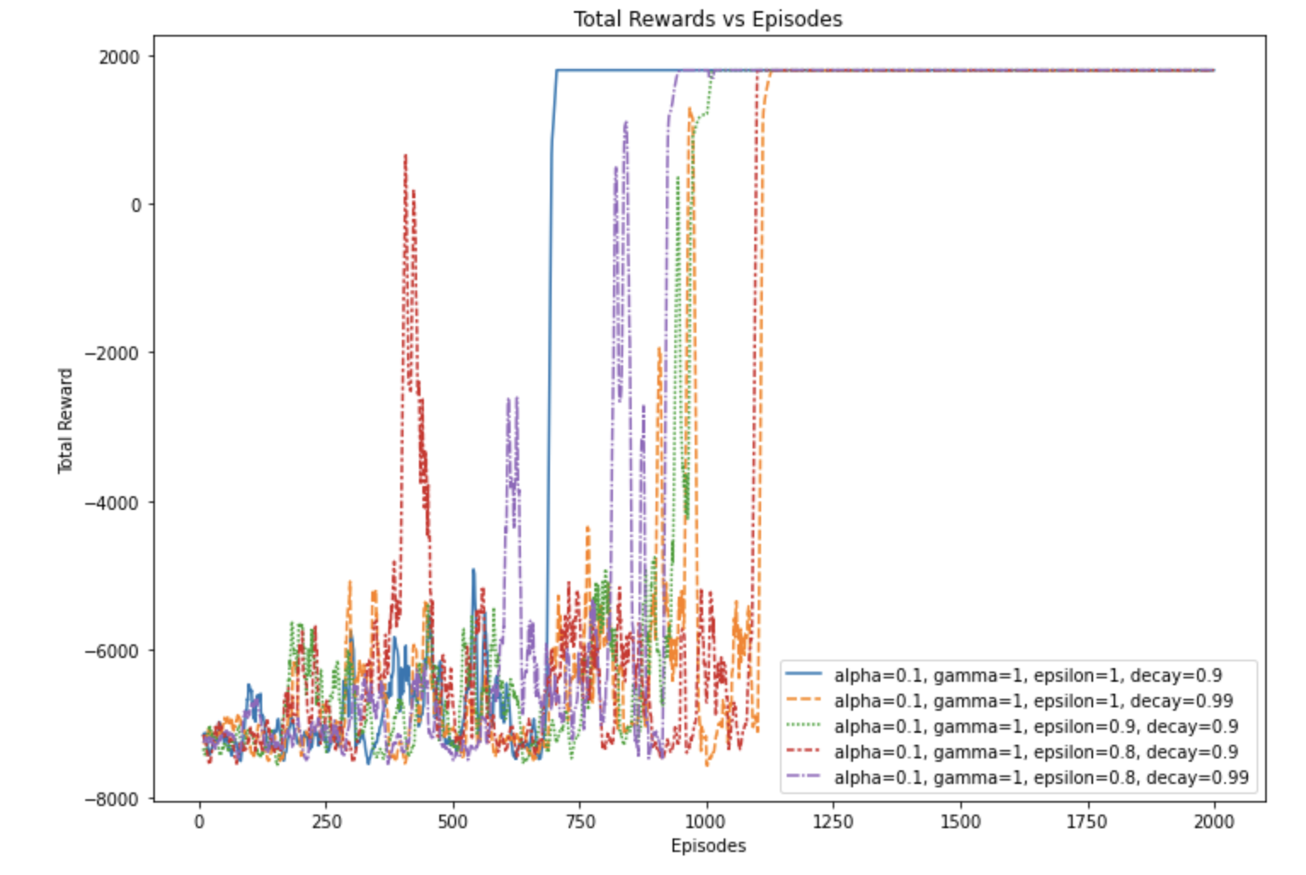
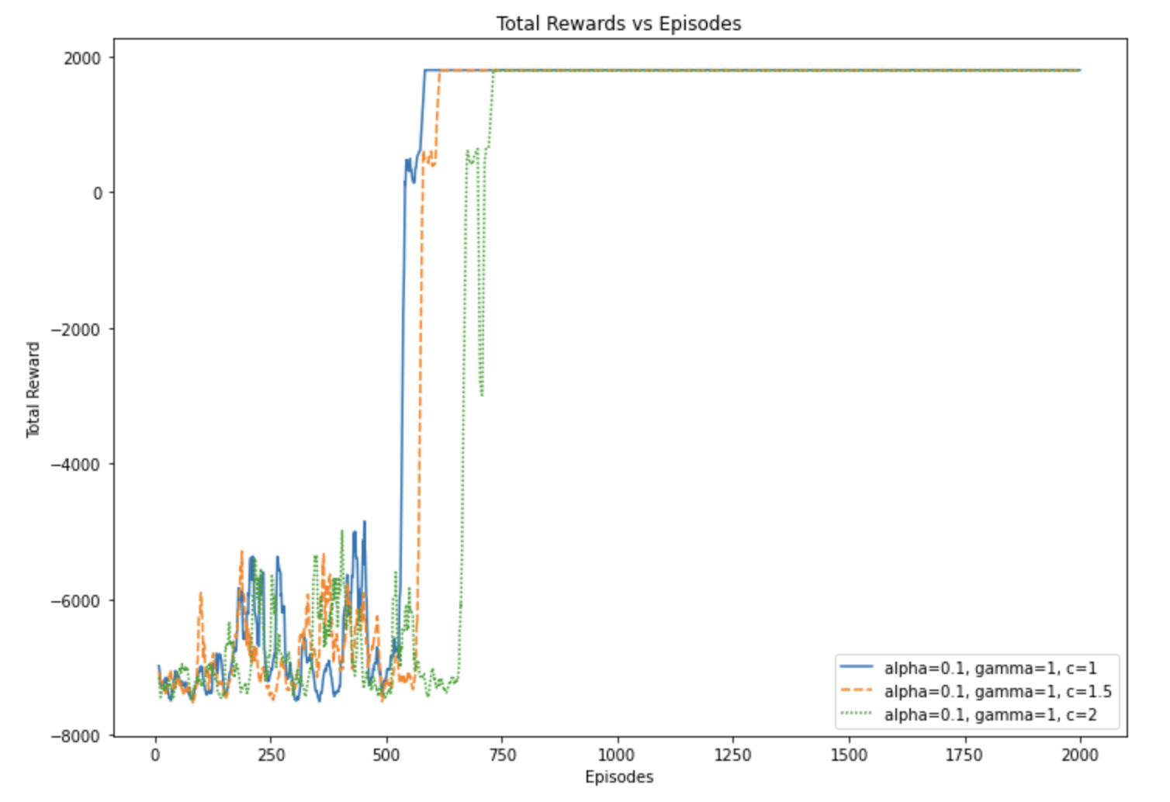
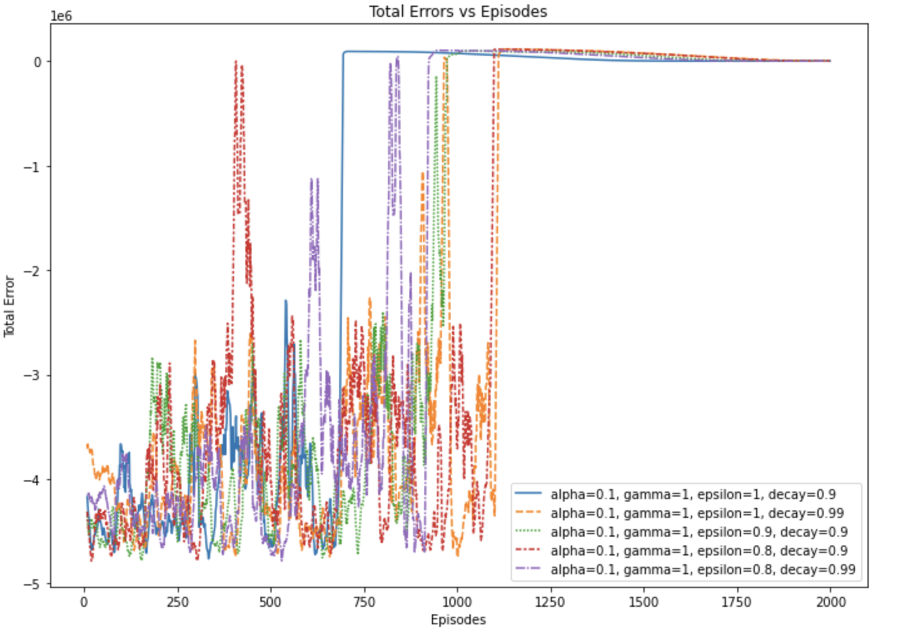
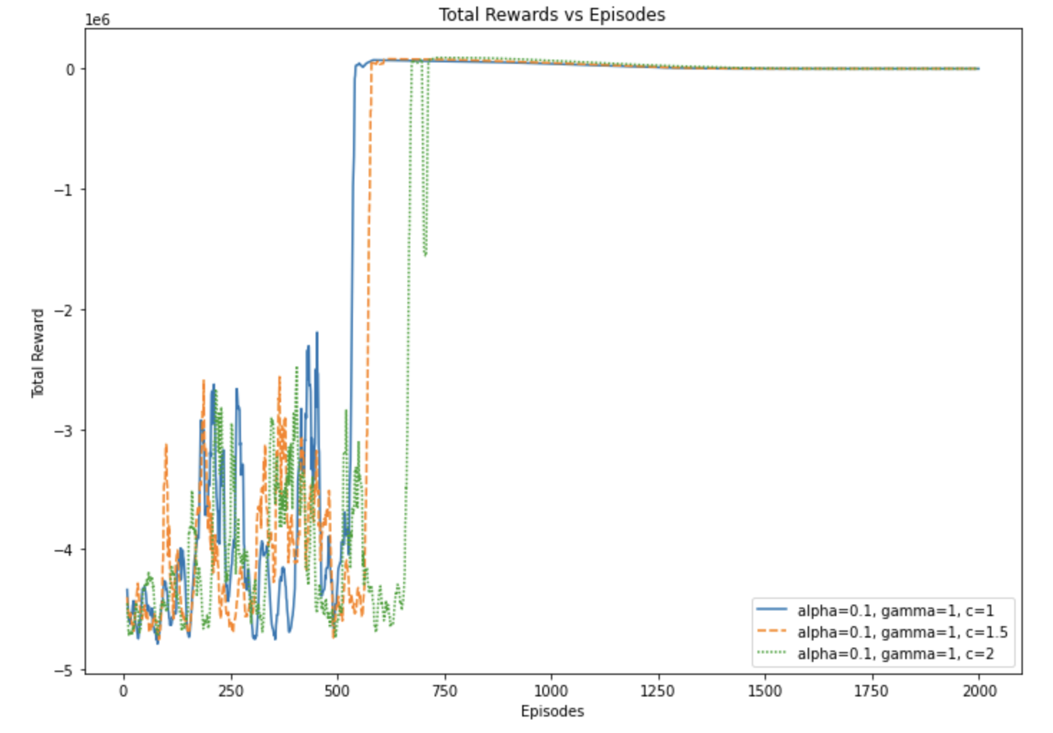
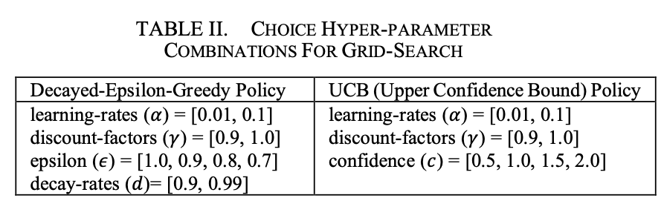
Epsilon-Greedy Policy
UCB (Upper Confidence Bound) Policy

Slide 8
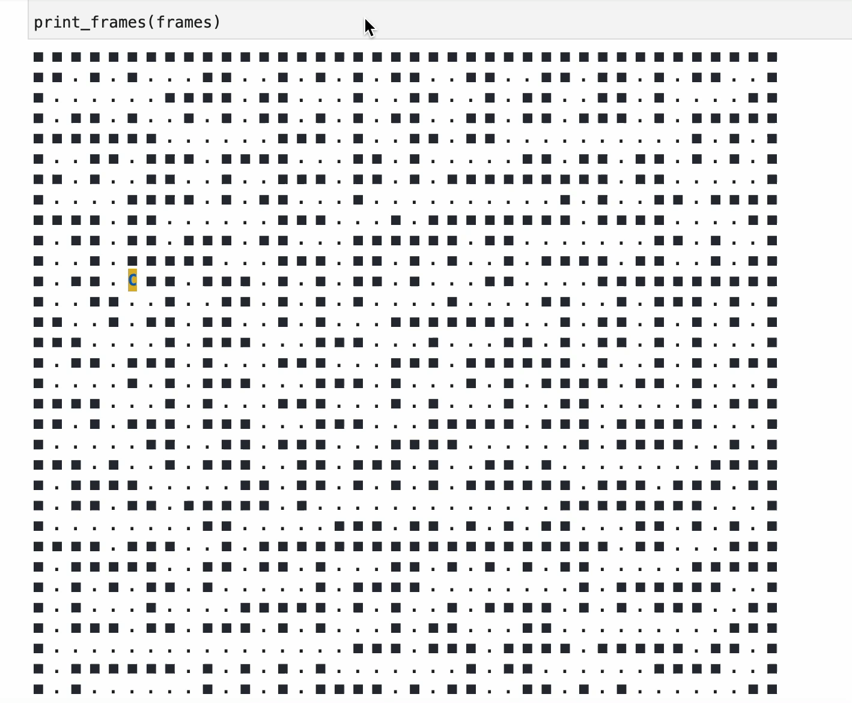
Final Q learning Model

Slide 9
Advanced Team Tasks

Slide 10
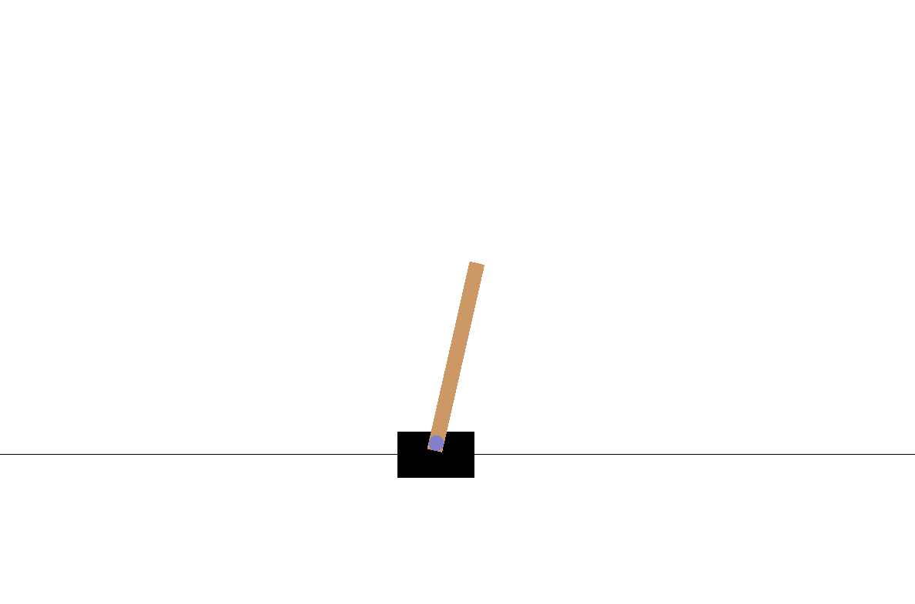
Introduction
Task
Cartpole Environment
Rewards
State Representation
(Cart Position, Cart Velocity, Pole Angle, and Velocity at the top of the pole)
Action Representation
Exertion of -1 (left) and +1 (right) forces
Episode Termination
Figure X: Snapshot of Cartpole Environment

Slide 11
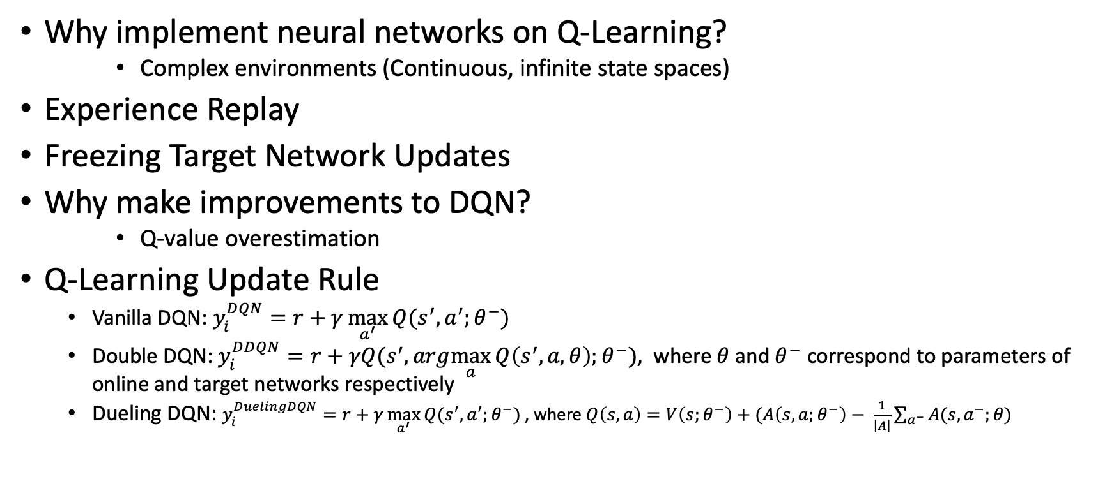
Technical Details
Why implement neural networks on Q-Learning?
Complex environments (Continuous, infinite state spaces)
Experience Replay
Freezing Target Network Updates
Why make improvements to DQN?
Q-value overestimation
Q-Learning Update Rule
Vanilla DQN: $y_{i}^{DQN}=r+γ\max_{a^{′}}{Q(s^{′},a^{′};θ^{−})}$
Double DQN: $y_{i}^{DDQN}=r+γQ(s^{′},arg\max_{a}{Q\left(s^{′}, a,θ\right);θ^{−})}$, where $θ$ and $θ^{−}$ correspond to parameters of online and target networks respectively
Dueling DQN: $y_{i}^{DuelingDQN}=r+γ\max_{a^{′}}{Q(s^{′},a^{′};θ^{−})}$ , where $Q\left(s,a\right)=V\left(s;θ^{−}\right)+(A\left(s,a;θ^{−}\right)− \frac{1}{\left|A\right|}\sum_{a^{−}}{A(s,a^{−};θ)}$

Slide 12
Implementation Details + Task Breakdown
Base Structure
Neural Network
Experience Replay/Memory
Agent
Initialisation of classes above
Epsilon-greedy action
Store transition
Fill memory
Sample memory
Reduce epsilon
Implement learning
Model Building
Implementation
Tuning
Computationally expensive and time intensive: Breakdown work and reduce hyperparameter range

Slide 13
Results – Single Run
Plots of Average Rewards for (Left) Vanilla DQN (Middle) Double DQN (Right) Dueling DQN

Slide 14
Results – Hyperparameter Tuning
Hyperparameter results for (Left) Double DQN (Right) Dueling DQN
For both double and dueling DQN, optimal results from hyperparameter tuning corresponded to 0.00001 and 1.0 for the learning rate and gamma, respectively.

Slide 15
Individual Task

Slide 16
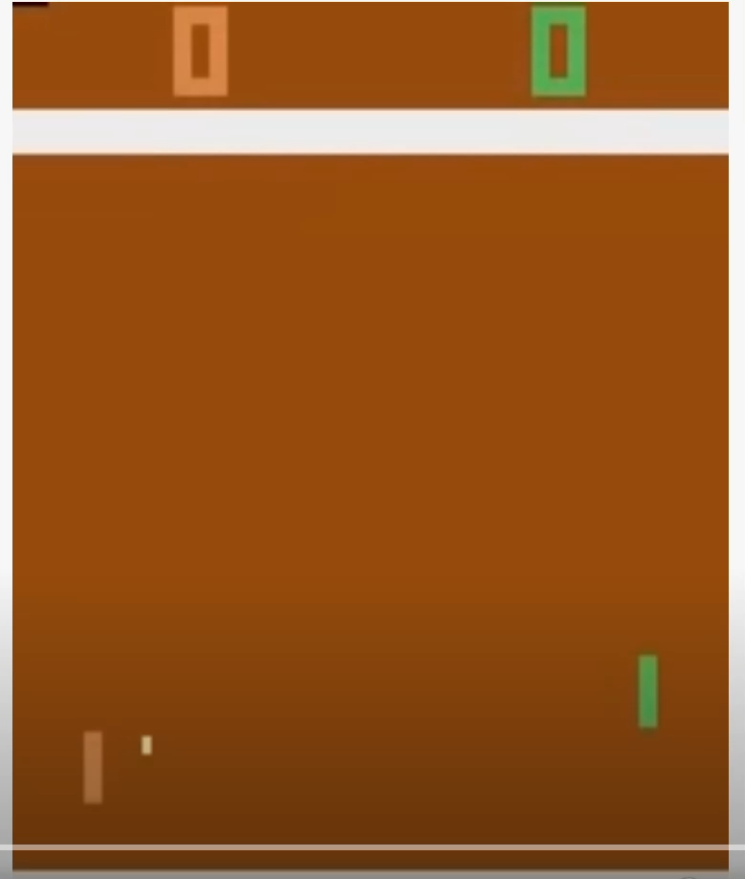
Q-Learning Implementation in Atari Pong Environment
Pong Atari 2600 environment
Graphic version
v4
Deterministic
6 discrete action space
['NOOP', 'FIRE', 'RIGHT', 'LEFT', 'RIGHTFIRE', 'LEFTFIRE’]
Policy:
Double DQN,
Dueling DQN,
Prioritized Replay,
Hyper-paramters adapted from Mnih et al 2015
(Learning rate = 1e-5, learning_starts=10000, explore=True, discount_factor=0.99, hiddens=[512], exploration_config=EpsilonGreedy, model-dims=84.)

Slide 17
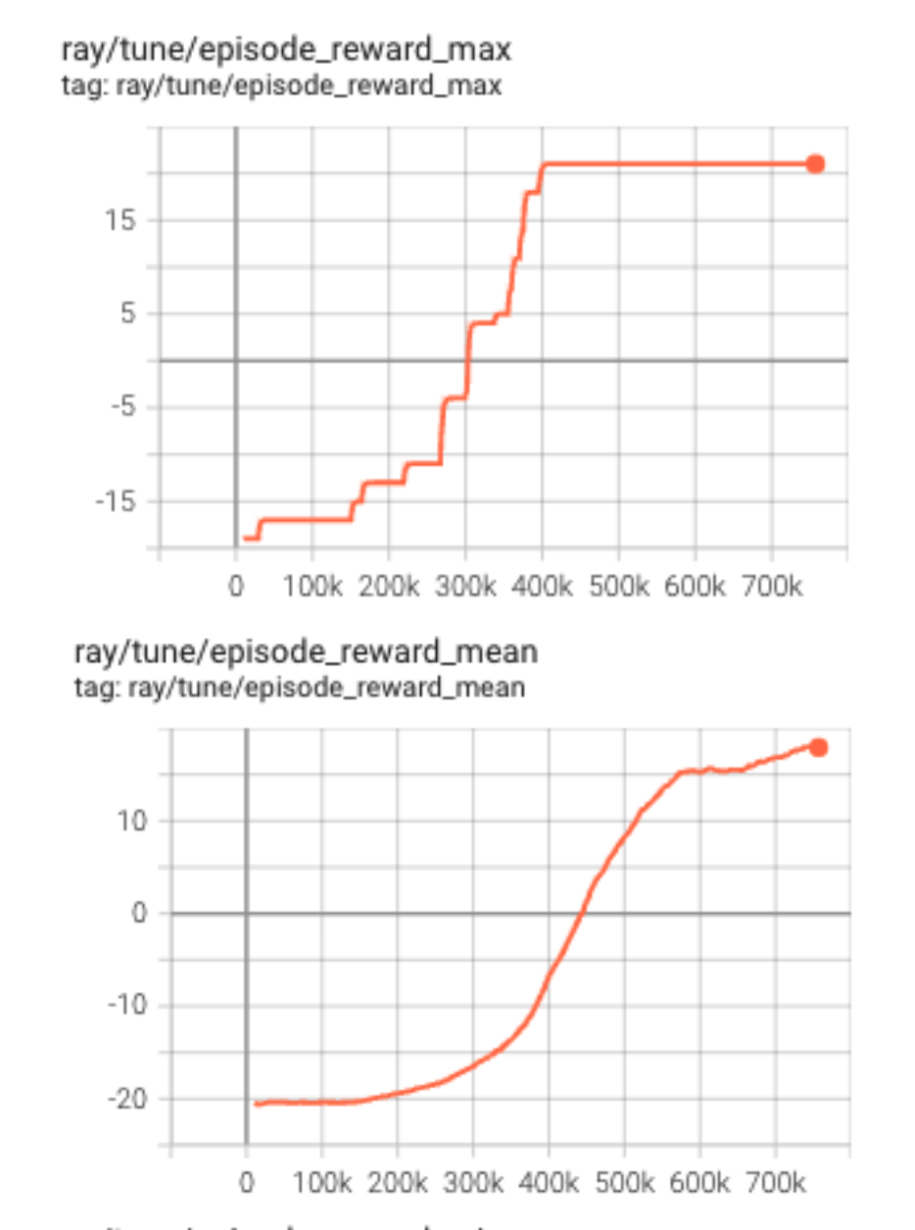
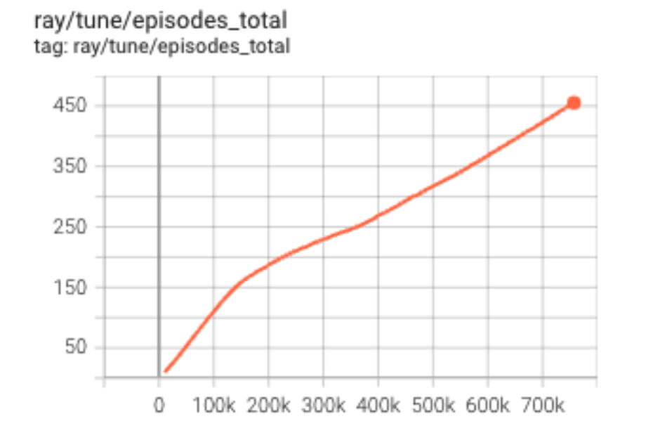
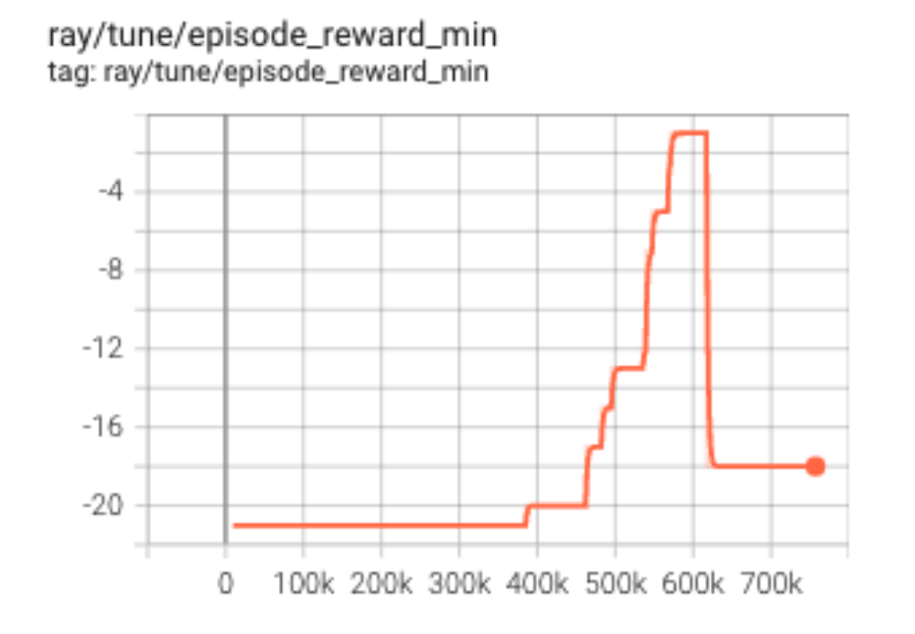
Training Results
757K time-steps (equivalent to 456 episodes ~ 2hrs)
Final episode_mean = 18

